Slide 1
SIGHT
A SCENT-like programming advisor
(and mediocre play on words)

Slide 2
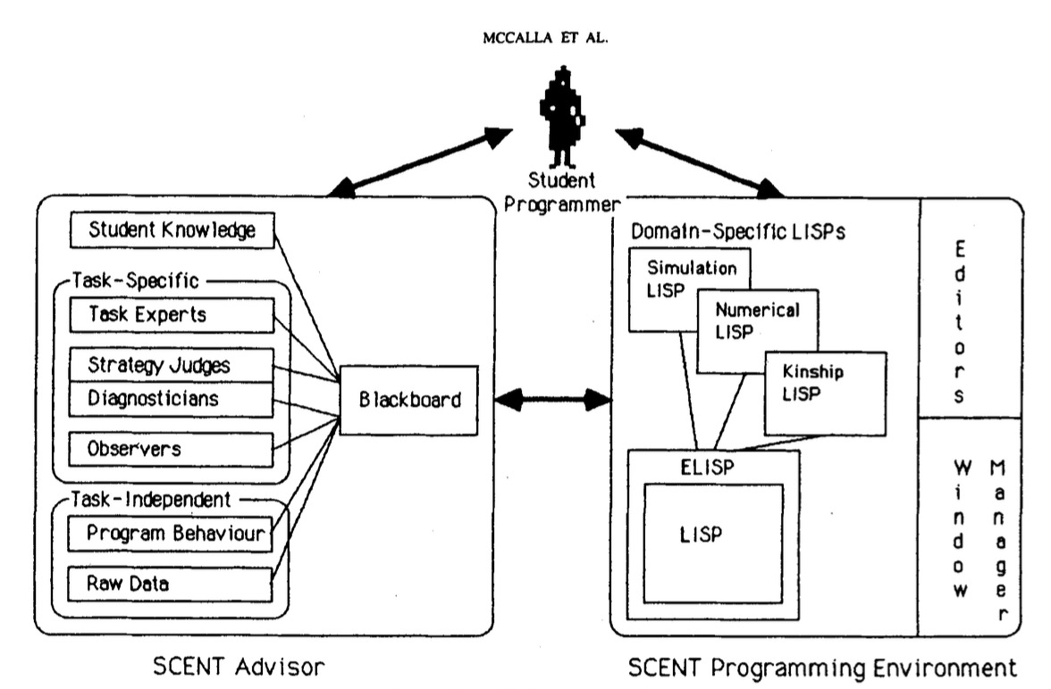

SCENT

Slide 3
LLaMa (2)
Trained on ”A new mix of publicly available online data”
General chat focused
Released for research purposes

Slide 4
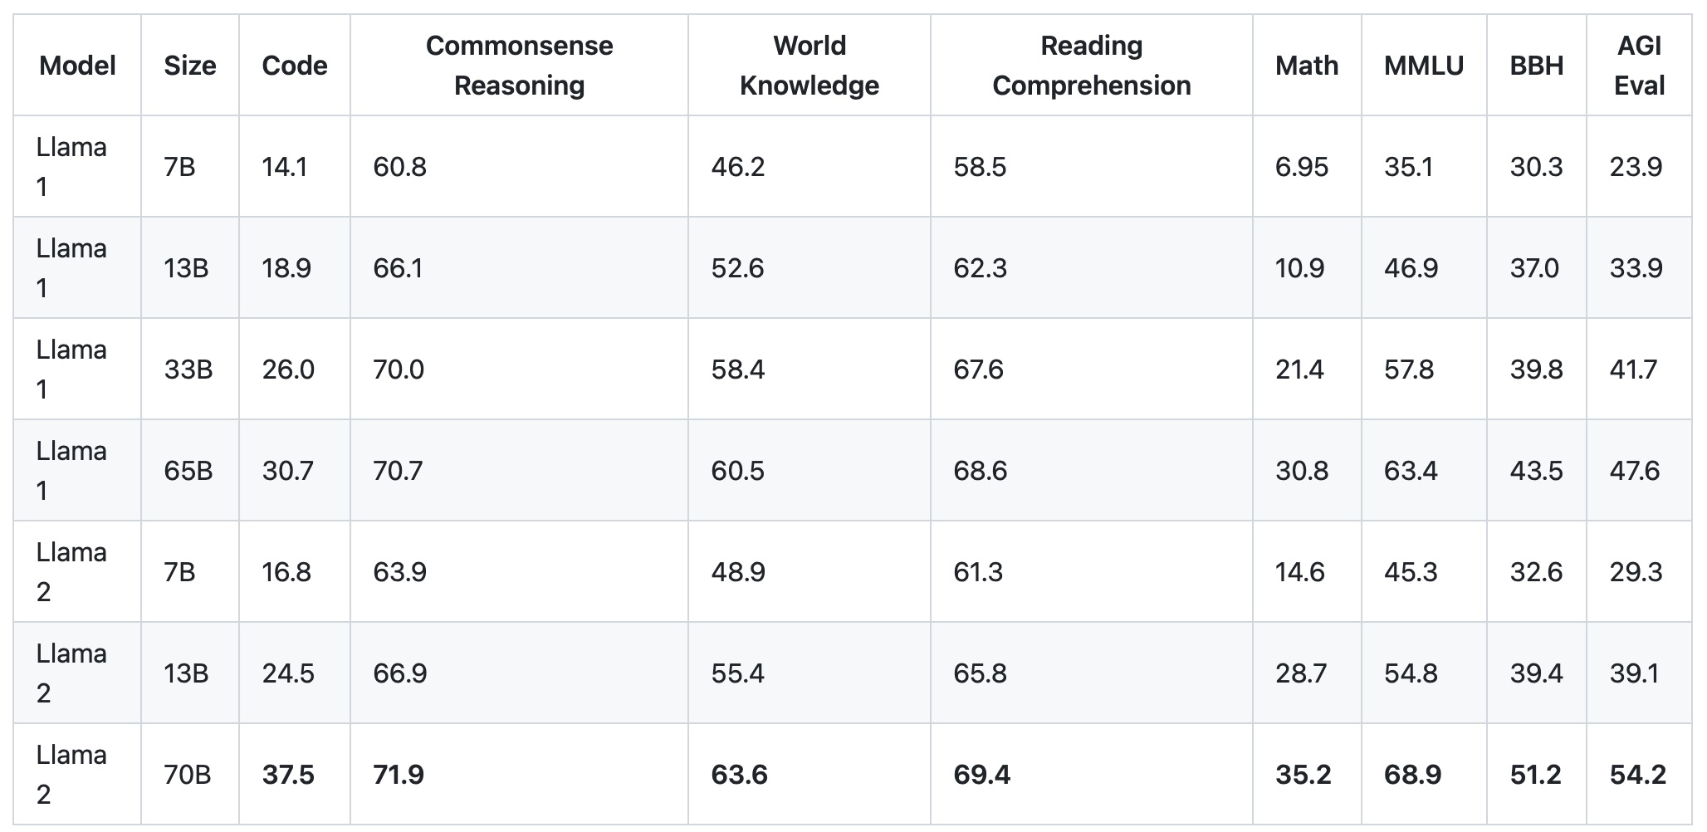

Slide 5
LLaMa (2)
Pros
Unlimited access
(relatively) quick response times
Customizability
Cons
Large compute requirement
Not trained for coding

Slide 6

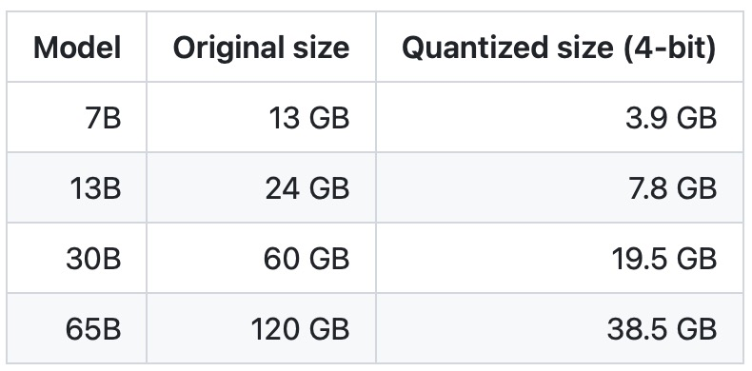

Slide 7

How to interact?
VSCode
#1 IDE
“easily” develop extensions

Slide 8
Takeaways
How do we model students generally, but with granularity?
NLP issue of text output
LLMs are incredibly unpredictable
Prompt engineering, huge impact on performance
Notes:
How do we model students generally, but with granularity?
NLP issue of text output
LLMs are incredibly unpredictable
Prompt engineering, huge impact on performance

